Slide 1
Rounding and estimating
EQ:How do we round and estimate and how do we know when to use each?

Slide 2
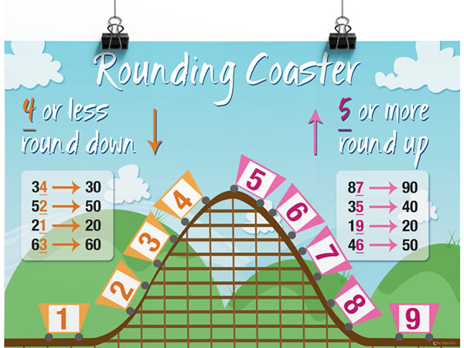
rounding
This is for rounding whole numbers. We do the same thing when we have decimal places too.

Slide 3
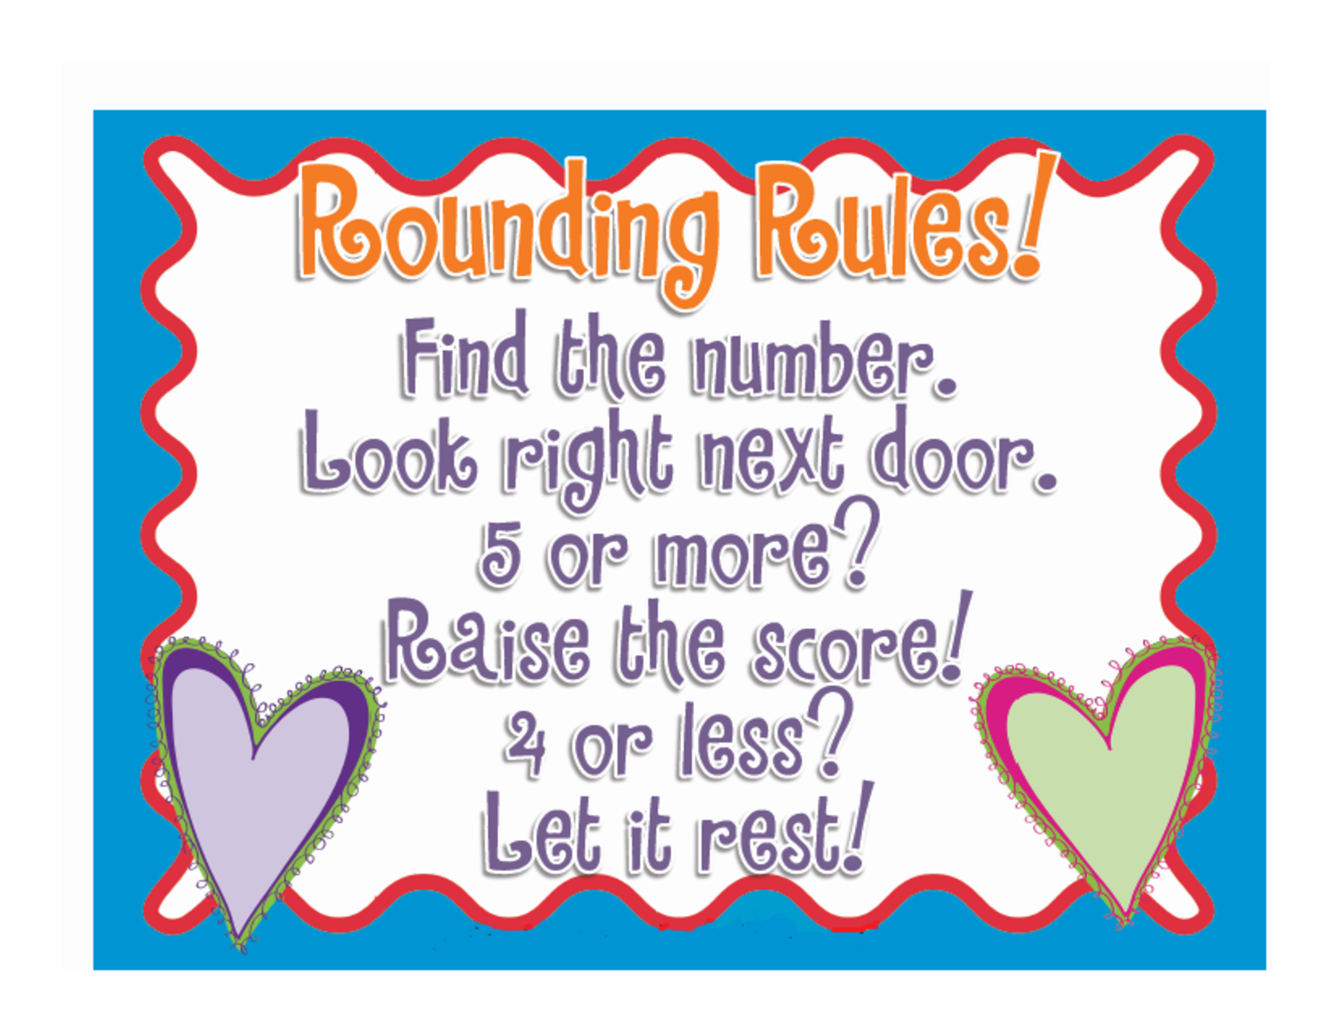

Slide 4

Rounding to a number of decimal places
Round 6.93247 to 4dp
-this means I want exactly 4 decimal places in my answer.
6.93247
6.9325
Is the 7 five or more?
Yes then the 4 will indeed become a 5.

Slide 5
Rounding Practise
Get to it!! Please.

Slide 6
Money
When we pay in cash we round money to the nearest 5 cents at the end of the transaction.
But if we are paying for items on card we will pay the exact amount.
$3.98 =$4.00 if you are paying cash
Now if I buy 3 items at $3.98
how much will I pay if using cash? Card?

Slide 7
Estimation
How do I use estimation to help my calculations?
Sometimes I don’t need exact answers. I just want an approximate answer?
Estimate 198 x 12
198 is almost 200 and 12 is pretty close to 10
So it is approx. 200x 10.

Slide 8
Your teacher will make some up
Hurry up Mr Craig!!

